Slide 1
Nomenclature of Carboxylic Acids
For acyclic saturated monocarboxylic acids, the longest hydrocarbon chain containing the –COOH carbon is identified as the parent chain. Then, the last -e of the parent hydrocarbon name is replaced with a suffix -oic acid.
The carbon in the carboxylic acid is named carbon #1. From that carbon you start counting to where your substituents have the lowest number possible.
Carboxylic acids are always at the end of the chain
You do not need to put the 1 in the name. It is always one!
Carboxylic acids are the highest priority.
Alkene/alkyne < alcohol < ketone < aldehyde < carboxylic acid

Slide 2
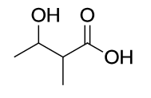
What is the name for the next molecule?

Slide 3
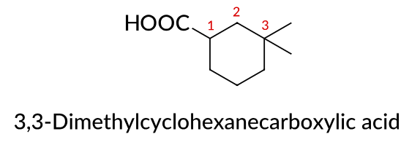
Nomenclature of Carboxylic Acids
In the case of cyclic carboxylic acids having –COOH groups directly attached to a cycloalkane ring or an aromatic ring, a suffix -carboxylic acid is added to the parent ring name.

Slide 4
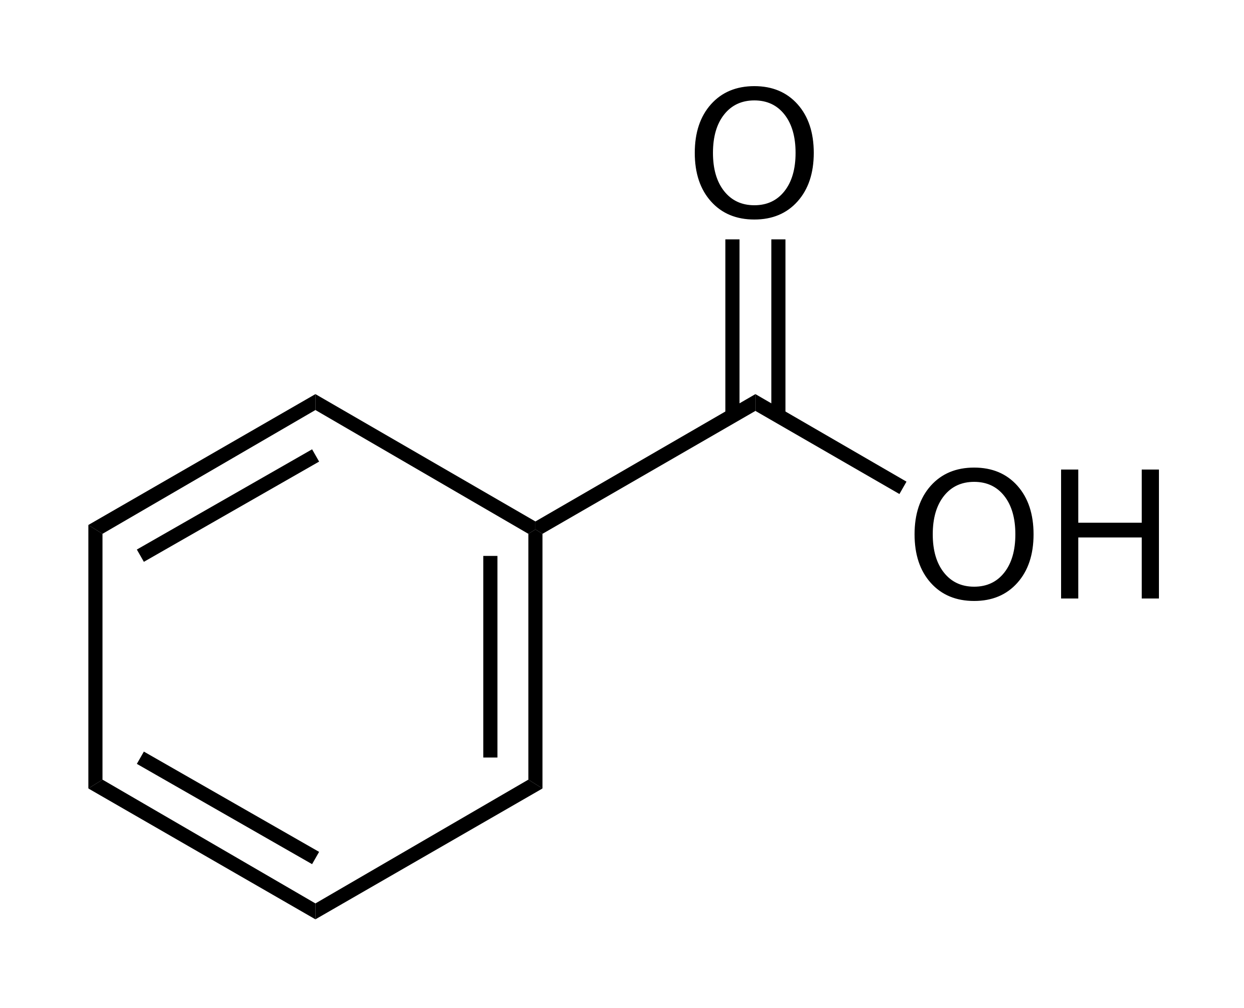
Nomenclature of Carboxylic Acids
Aromatic carboxylic acid: benzoic acid.
Nomenclature:
o-m-p: when you have two substituents
IUPAC: for when you have three or more.
The carboxylic acid functional group is always carbon #1.

Slide 5
Reactions of Carboxylic acids
Preparation: Complete oxidation of a primary alcohol (We’ve seen this one)
Neutralization
Fischer Esterification
Reduction
Notes:
https://www.chemistrystudent.com/alkanescombustion.html

Slide 6
Preparation
Complete oxidation of a primary alcohol (passing through an aldehyde).

Slide 7
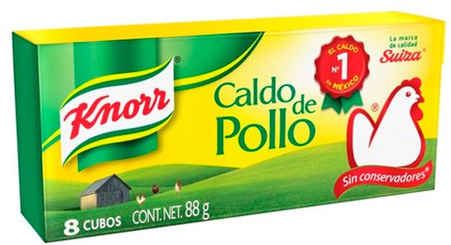
Neutralization
Carboxylic acids are weak acids.
Since they are acids, they can be neutralized with a base.
CH₃—COOH + NaOH → CH₃—COO– Na⁺ + H₂O
acetic acid sodium acetate
(carboxylic acid salt)
Are used as preservatives and flavor enhancers.

Slide 8

Fischer Esterification
Esters are produced when carboxylic acids are heated with alcohols in the presence of an acid catalyst. The catalyst is usually concentrated sulphuric acid.
The equation for the reaction between an acid RCOOH and an alcohol R'OH (where R and R' can be the same or different) is:
How can we drive the equilibrium forward?

Slide 9
+ H₂SO₄

Slide 10
Reduction
The reaction happens in two stages - first to form an aldehyde and then a primary alcohol. Because lithium aluminum hydride reacts rapidly with aldehydes, it is impossible to stop at the halfway stage.
Sodium borohydride is not strong enough for this reduction
Since the reaction CANNOT be stopped at the aldehyde, you can write the reaction straight to alcohols.
+ LiAlH₄ + LiAlH₄
If you want to take a look at the mechanism, check this video
https://www.youtube.com/watch?v=zR4OaoiNkA0

